Slide 1
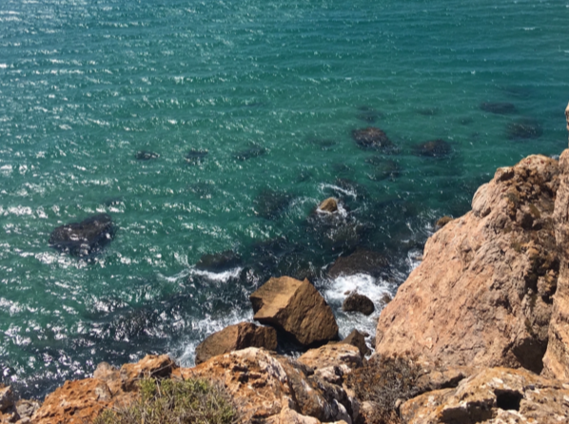
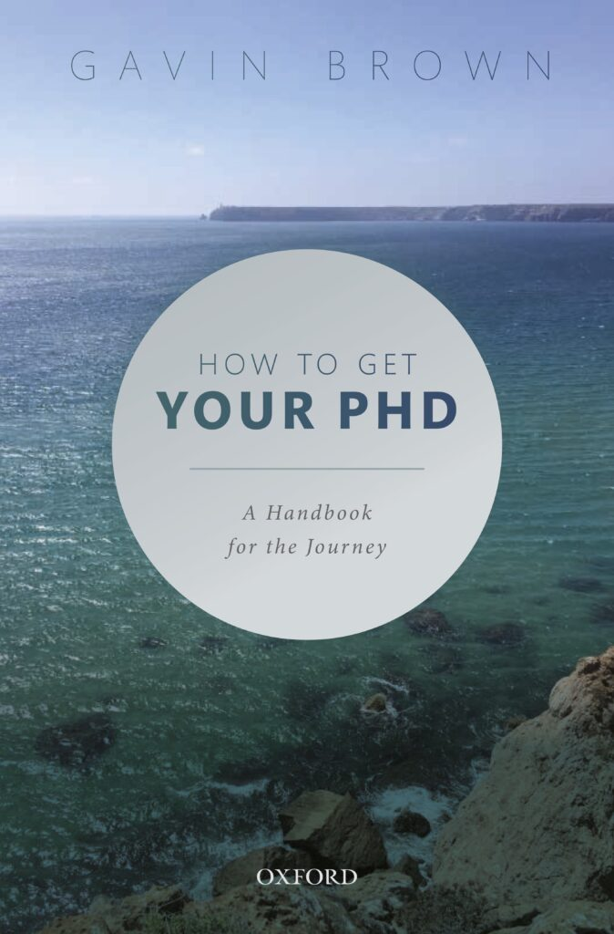
How to Get Your PhD
Department of Computer Science
PGR Symposium 2021
Professor Gavin Brown
Machine Learning & Robotics Group
University of Manchester
Slides will be made available.

Slide 2
Disclaimer
Listen to your supervisor.
I will give non-subject specific advice here,
but your supervisor knows you,
and your PhD,
and knows what is appropriate in your area.

Slide 3
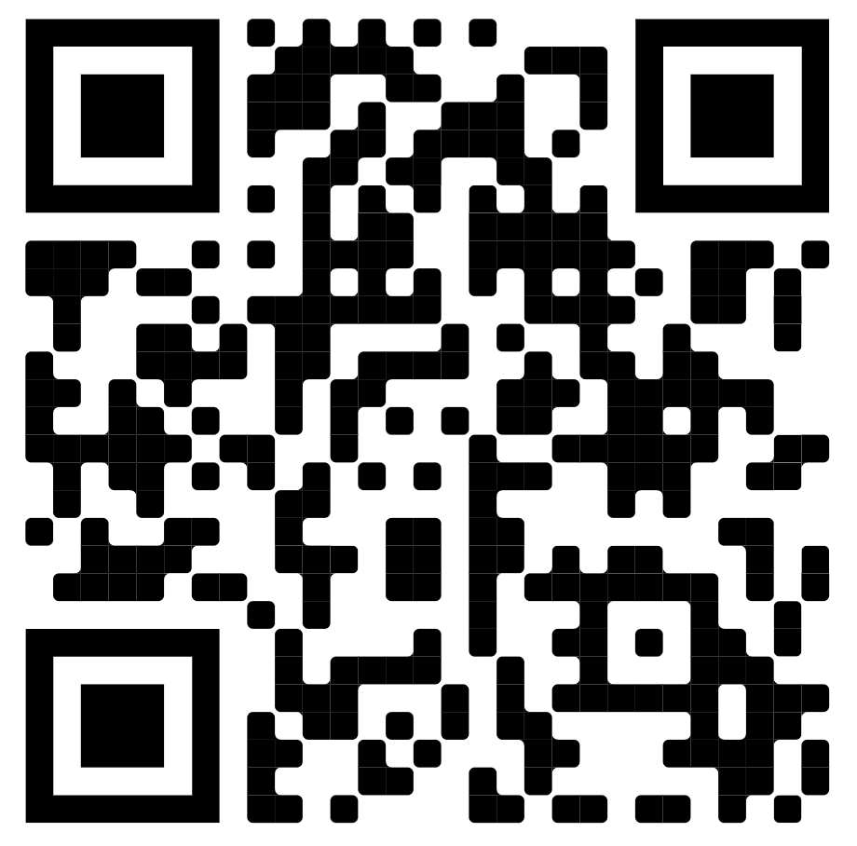
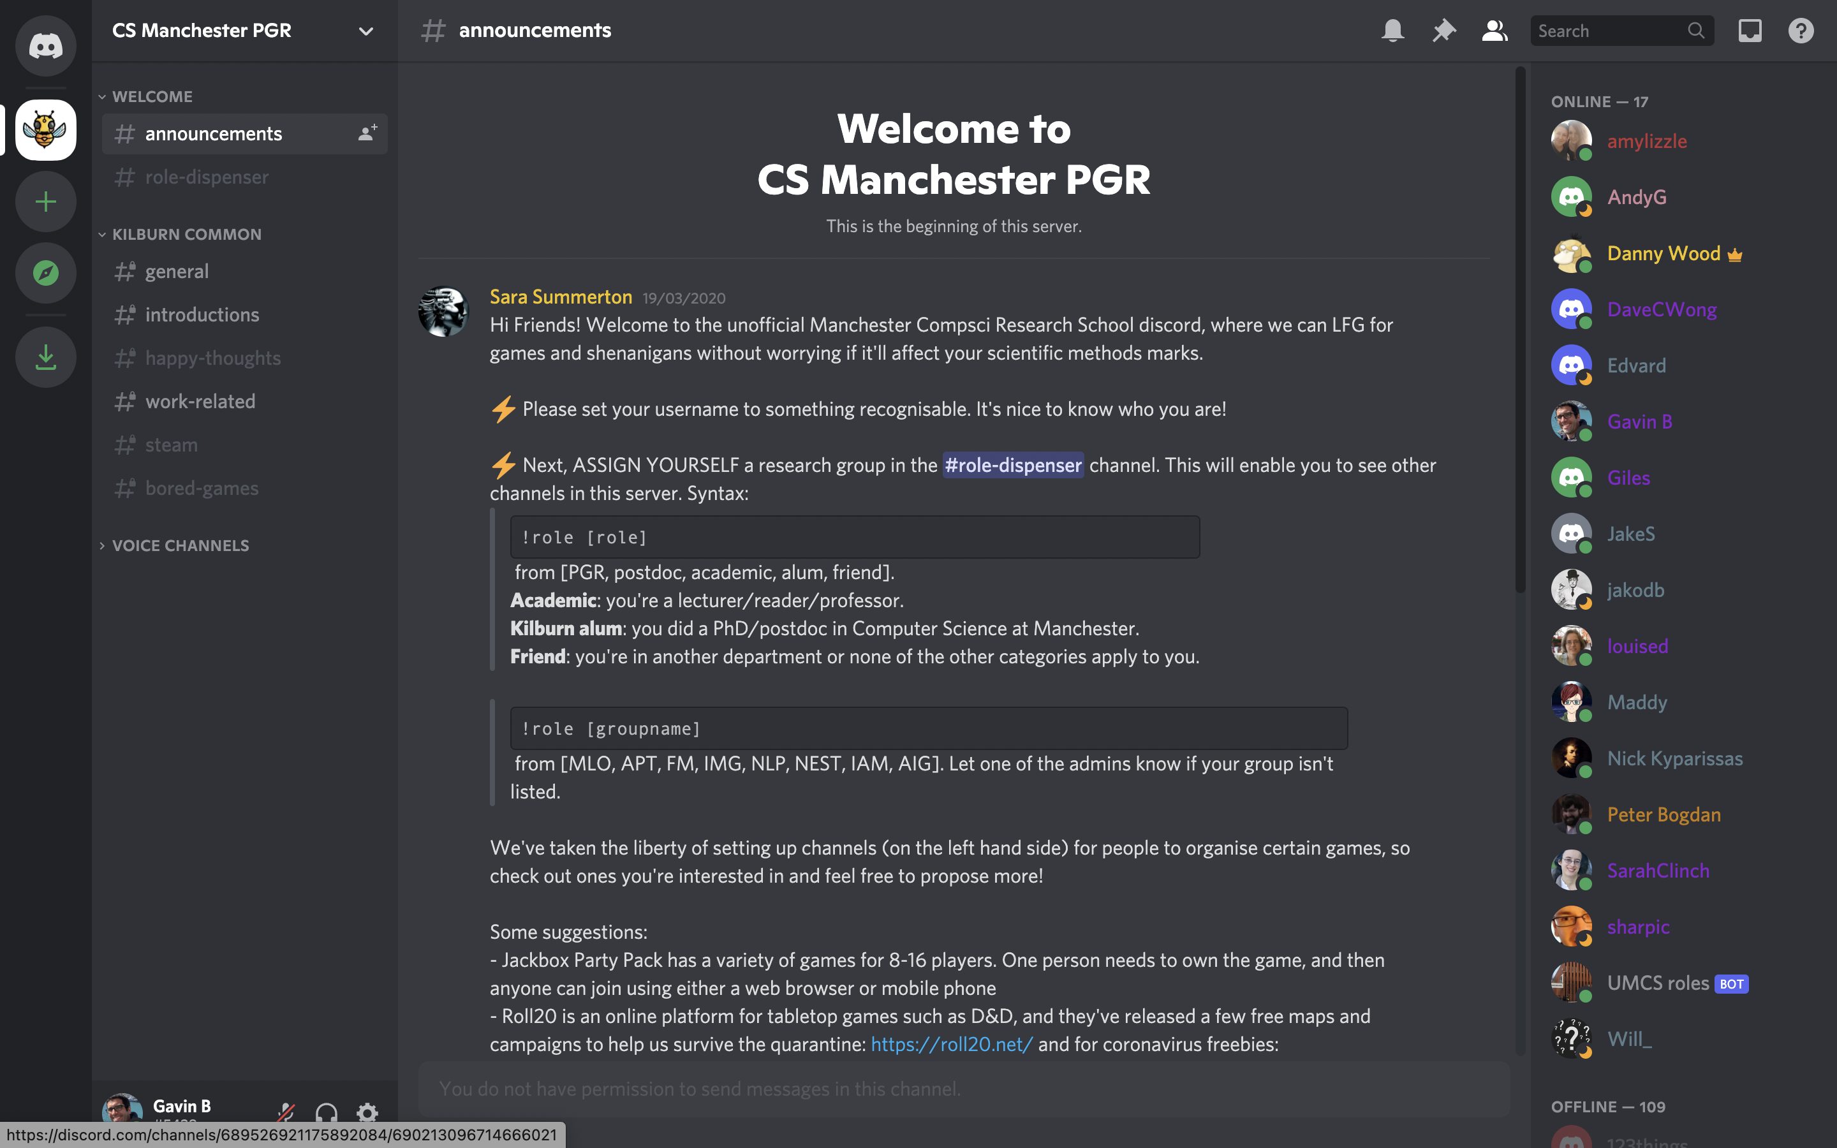
Advert: The CS PGR Discord Server
Community-building is hard. Especially in a pandemic.

Slide 4

Today’s Talk
What is a PhD?
Things that will happen
How to read
How to write
Intellectual challenges
Emotional challenges

Slide 5
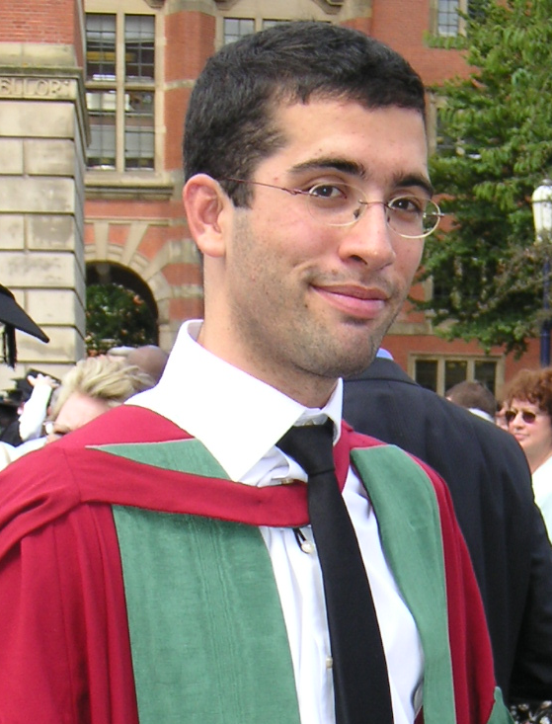
Me.
Jan 2004 PhD on neural networks, now known as “deep learning”
BCS Distinguished Dissertation 2004
What you don’t see….
  Failed my first year transfer report.
  Thought about quitting many many times.
  Got very depressed.
  Viva gave me “major corrections”.
Nov 2004 Lecturer
Aug 2012 Senior Lecturer
Aug 2017 Professor & Director of Research
Supervised 17 students through to a PhD.
Examined ~25 others around the world.

Slide 6
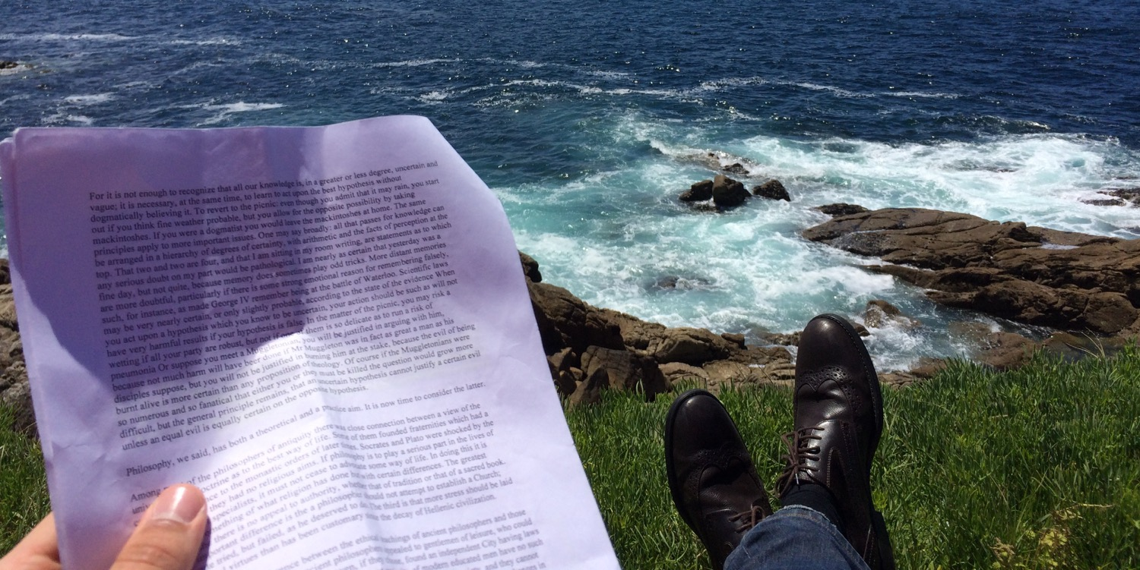
What is a PhD?
An amazing time. Time to relax and pursue your interests.
…With your intellectual freedom, you can explore a sea of knowledge.
… and contribute your own novel idea to change the world.

Slide 7

Or is it more like
…this?
You
Your supervisor

Slide 8
What is a PhD?

Slide 9
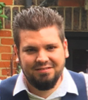
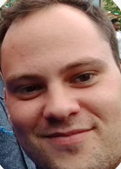
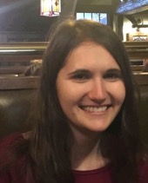

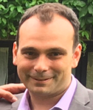
You always say that…
Nooo!
These are some of my PhD students.
There’s one thing that they hear me say, again, and again…
Don’t’ say it again…
Yawwwwwwwnnn!
What is a PhD…?

Slide 10
If PhDs were easy, everybody would have one.
But they’re not.
So, they don’t.
PhDs are not meant to be easy.
They are meant to be hard.
What is a PhD…?

Slide 11

There is no “ultra-super-PhD” above this.
You’ve reached the top – congratulations!
Click here to apply for our ultra-super-PhD!
What is a PhD…?

Slide 12

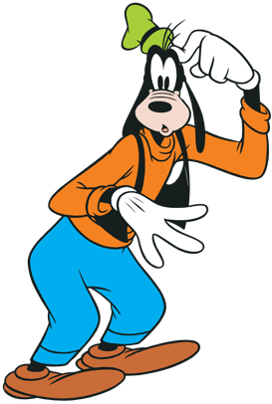
No PhD
Which path am I on!?
PhD
What is a PhD…?

Slide 13


Nothing I say here will stop you experiencing this.
So, I have two aims:
To give a little reassurance, that everything you feel is normal
To provide some useful tips to move a bit faster, more efficiently
What is a PhD…?

Slide 14

What is a PhD?
A training programme where you learn the professional skills needed for doing “research”.
  “I wanted to know about holidays in Italy,
  so I did some research and found a great place ...”
  “I was going to buy him a DVD for Christmas,
  but I did my research and realised he’d like a book instead…”
No, you didn’t. You Googled for 30 minutes.
No, you didn’t. You asked a few people.
Society has corrupted the word “research”.
What is a PhD…?

Slide 15
What is a PhD?
A training programme where you learn the professional skills needed for doing “research”.
The professional skills of a researcher are just as valid and challenging as…
that of a lawyer (reasoning, evidence collection, client interactions, etc)
that of a doctor (patient empathy, quick reasoning under pressure, etc)
that of an architect (knowing/applying regulations, listening, creativity, etc)
What is a PhD…?

Slide 16
What is a PhD?
A training programme where you learn the professional skills needed for doing “research”.
Research is...
Being ok with going into the unknown - there is no syllabus
Breaking down big problems into manageable ones
Being systematic and creative at the same time
Putting your heart and soul into an idea
Accepting critical feedback
And more…
But it is not…
a time where you’re expected to invent something that changes the world.
What is a PhD…?

Slide 18
What we’ve done…
What is a PhD?
Things that will happen
How to read
How to write

Slide 19
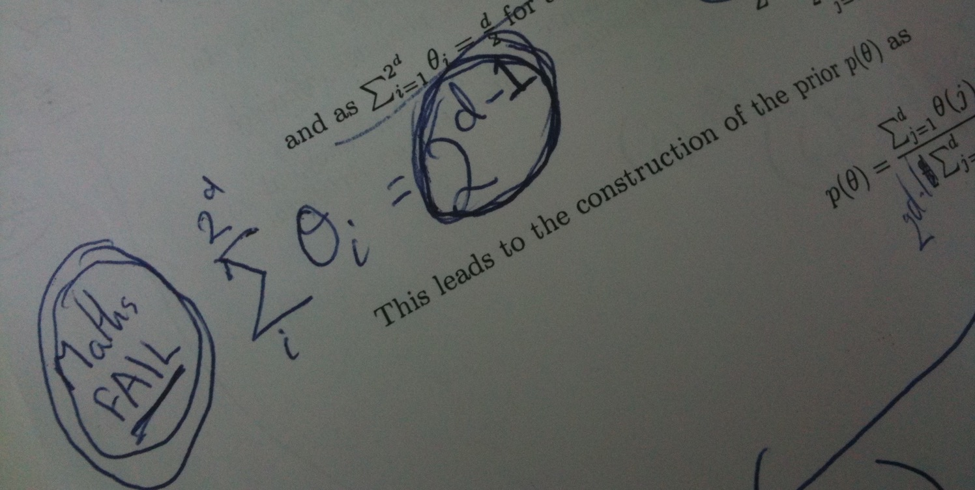
Things that will happen
(and it’s still all ok)

Slide 20

You’ll feel complete joy.
You will...
- learn things you find so exciting, that you’ll explode!
- do things you never thought possible!
- you will realise you are actually pretty smart!
Things that will happen….

Slide 21

You’ll feel stupid, and inadequate.
Things that will happen….

Slide 22
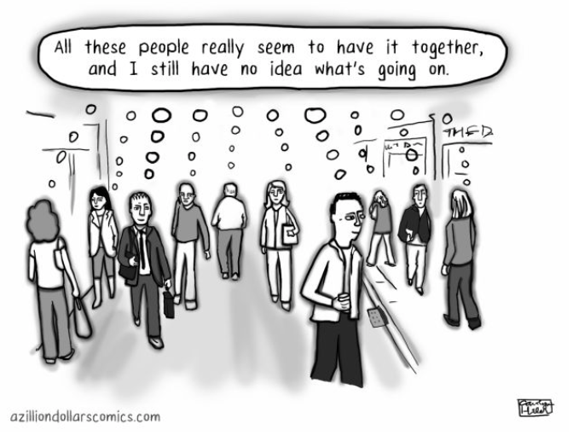
You’ll feel stupid, and inadequate.
It’s normal. It’s called “Impostor syndrome”.
Things that will happen….

Slide 23

You’ll feel stupid, and inadequate.
If you’re not feeling insecure, you’re not at your limits.
If you’re not at your limits, you’re not doing research.
But that’s ok.
Things that will happen….

Slide 24
You’ll ride the rollercoaster.
Wohoo I got into a conference!
I love my topic.
I love my supervisor.
Wow I’m so smart.
But it’s all still ok.
This is normal. This is research.
Oh wow my experiment looks like it’s working!
Post-conference blues. Back to real life again…
Huh? I have to throw away 3 months of literature review?
Oh. A bug.
Great.
I’m so dumb.
How did HE get a paper published?
Really? You take 2 months to read my draft?!!
Things that will happen….

Slide 25
You will want more meetings with your supervisor.
Your supervisor is not your teacher. It is not their fault.
Try to resist “The Blame Game”.
They are not the only person you can learn from.
… Reach out to others - staff, students, everyone!
Why do you feel this?
Frustration
You will want fewer meetings with your supervisor.
“I don’t have anything worth showing…”
Resist this. Isolating yourself = Fatal PhD mistake.
They want your work to succeed.
Why do you feel this?
Shame
Things that will happen….

Slide 26

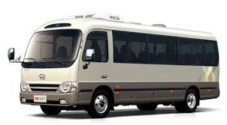
You will procrastinate.
You will not know what to do with your day.
So you will feel like you’ve wasted time.
During my PhD I…
But that’s all ok.
And I didn’t feel guilty.
Wrote code that counted the number of words in my thesis
Wrote lots of scripts to automate various things (that didn’t need automating)
Wrote code to help my officemate’s research (he didn’t ask)
Got very good at firing elastic bands accurately (at my officemate)
Learnt British Sign Language
Learnt to rollerblade (including stunts)
Learnt to drive a bus
Things that will happen….

Slide 27
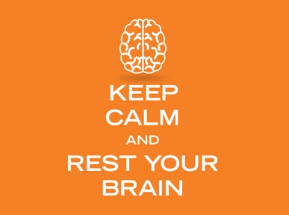
You will procrastinate.
But it’s all still ok ... why?
Because your brain needs downtime.
It must be balanced with real work of course.
But some degree of procrastination is GOOD for you.
Things that will happen….

Slide 28
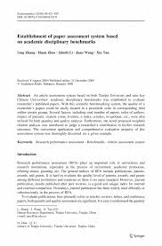
You will have your work rejected.
It might be formally (e.g. from a conference)
It might be informally (e.g. a friend finds big problems with your new idea)
It might be unjustified (e.g. a low quality paper review)
We regret to inform you…
But that’s all ok.
If you don’t get rejections… you’re probably not taking enough risks.
If you’re not taking intellectual risks, you won’t feel insecure.
If you’re not feeling insecure, you’re not at your limits.
If you’re not at your limits, you’re not doing research.
Things that will happen….

Slide 29
You will…..
succeed.
In small ways, and BIG ways.
So, just keep going.
More than anything, a PhD is…
a test of your endurance and adaptability
Things that will happen….

Slide 30
PhD Bingo!
How many do you have?
Feel complete joy
Feel stupid and like an impostor
Ride the rollercoaster, up and down
Want more meetings with your supervisor
Want fewer meetings with your supervisor
Procrastinate. Lots.
Have work rejected.
Succeed.
Things that will happen….

Slide 32
What we’ve done…
What is a PhD?
Things that will happen
How to read
How to write

Slide 33
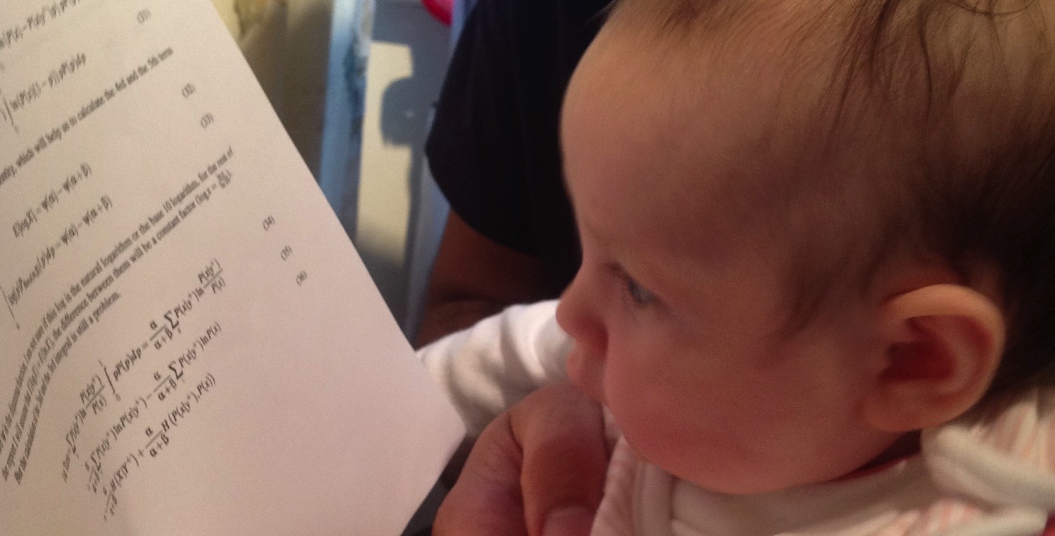
How to Read

Slide 34

Reading the literature …

Slide 35
How can you read
all the papers?
“Inner” Circle
Probably 1-3 papers.
You will know these inside out
You remember the wording and text
Marked up with highlighters and pen
May have contacted the authors
The very core of your thesis idea
BEFORE you read in detail…
KNOW where it goes.
“Middle” Circle
Probably 5-20 papers.
Related, but not exactly your idea
Probably competitors to your method
You know them well, and why they’re not in your inner circle.
Will go in your literature review
Inner
“Outer” Circle
30+ papers.
Background literature, you’ve skim read them, but not in detail.
Not direct competitors to your idea
You might cite them, if they’re lucky
Middle
Outer circle

Slide 36
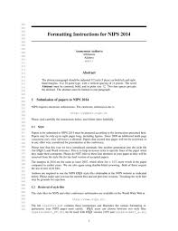
Read it out of order.
I read the abstract: to find out what it’s about
Then the conclusion: to find out what they claim.
Then look at figures: to see if I find support for their claims.
Then (and only if I like it) I read the rest.
The difficult bits?
I skip details if I don’t get it.
If I think “inner circle” I invest the time.
Silly question of the Day
“How many papers do you read a week?”

Slide 37
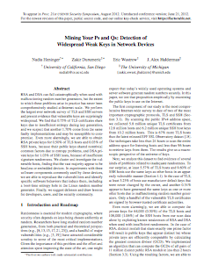
Originality … WHAT have they done?
How to judge a paper?
Significance … WHY did they do it?
Rigor … HOW did they do it?

Slide 38
Originality… the WHAT? question.
What do the authors claim they have achieved?
Are they addressing a new / complex problem?
Proposing a new solution to an old problem?
New perspectives, arguments, or insights about a problem or solution?
How does it relate to other papers you know? An extension? A special case?
In simple language:
How novel is this particular paper, really?

Slide 39
Significance… the WHY? question.
Is this really an important problem to solve, or an important proposed solution?
What is the evidence that other people really care about it?
How many subsequent papers have cited this one?
Are the results really that surprising compared to other work you’ve seen?
Even if they are addressing an important problem — are they addressing it properly, without making too many simplifying assumptions?
In simple language:
Who cares?

Slide 40
Rigor… the HOW? question.
How thorough have the authors been in their investigation?
Have they considered all the relevant literature — are there papers that they should have cited, or compared their ideas/results to?
Are the experiments or results reproducible by others?
Are there unwritten assumptions, that they assumed nobody will notice?
Do they present sufficient evidence to really convince you of each of their claims?
In simple language:
How easy is it to pull a hole in the paper?

Slide 41

UK govt mechanism for allocating University funding.
Our papers are judged and graded… [ 0, 1, 2, 3, 4 ]
The criteria? Originality, Significance, Rigor…

Slide 42


Make work for you.
1. Type what you do into Google Scholar.
2. If you don’t know everything on page 1…
...there’s a problem.
I don’t mean understand everything on page 1.
I just mean know the existence of everything on page 1.
(and of course be able to say why it’s not relevant)
Simple rule for this…
I should not be able to surprise you
with a paper from page one!

Slide 43
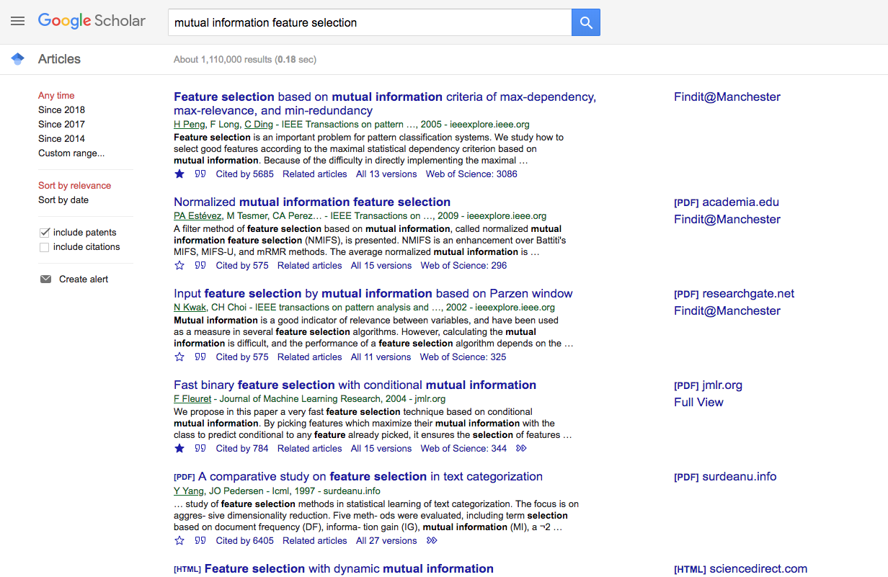

Make work for you.
Know it 100%.
Inner circle
40%. Middle.
20%. Middle.
Know it 90%.
Inner circle.
10%.
Outer circle.

Slide 44
Make work for you.
Repeat this, once a month.
Try keyword variations by synonym:
“feature selection data” ---> “variable selection dataset”
“energy prediction” ---> “energy modelling”
“mutual information. ---> “information theoretic”
“deep learning” ---> “neural net(s)”

Slide 45
True understanding.
How do you know if you “understand” something?

Slide 46
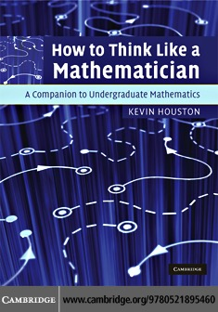
True understanding. (Chapter 34)

Slide 47
True understanding.

Slide 48
True understanding.
I rarely say I truly “understand” something.
Try to keep the bar HIGH.
Reserve that phrase for special occasions.

Slide 51
What we’ve done…
What is a PhD?
Things that will happen
How to read
How to write

Slide 52

How to Write

Slide 53
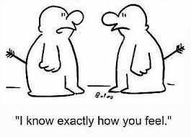
Good writing requires empathy.
Write with someone in mind.
Understand and respond to them as you write.

Slide 54
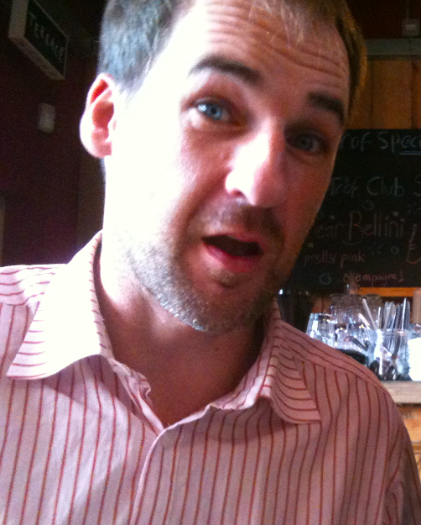
Good writing requires empathy.
Write with someone specific in your mind.
I don’t get it. What do you mean?
That doesn’t make any sense, Gav.
I imagine his reactions, while I’m typing.
I always used him because I know him well, and I can predict his reactions.
I hold other friends/family in my mind for different styles of writing – e.g. my mum.
My PhD officemate, John.

Slide 55
Make it easy for your reader.
Golden Rule - Be human, be yourself.
Don’t use big words for the sake of it.
Write as if you’re talking to a friend, teaching them your new idea.
Questions to ask yourself…
Who will read this?
What is their background?
What will they think/feel?
For what parts would they say “I don’t get it”?

Slide 56
Write the contents page first.
2 pages
Introduction : What is this thesis about?
Background: The Basics of Feature Selection
A new type of data: Positive-Unlabeled data
  Why is PU data important?
  Why is feature selection in PU data challenging?
  What techniques exist?
  What are their weaknesses?
A Novel Algorithm for FS in PU data
An Empirical Analysis of Our Algorithm
Use question marks in section headings, and make sure you answer the question!
5 pages
0.5 page
1 page
Make sure the content page reads as a story by itself.
1 page
3 pages
1/2 page
2 pages
Plan a page budget.
And stick to it.
5 pages

Slide 57
This your thesis “skeleton”…
Introduction : What is this thesis about?
Background: The Basics of Feature Selection
A new type of data: Positive-Unlabeled data
  Why is PU data important?
  Why is feature selection in PU data challenging?
  What techniques exist?
  What are their weaknesses?
A Novel Algorithm for FS in PU data
An Empirical Analysis of Our Algorithm
Done.
Done.
Now just fill in empty parts!
Done.
Done.
Almost finished!

Slide 58
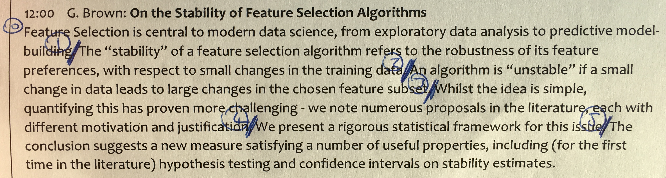
Look at your writing. Really look.
Mark the end of every sentence with a pen and number them.
If it extends over 3 lines, it’s too long. Perhaps break the sentence up.
If you removed sentence N, would it still read ok? If so, cut it.
What is the purpose of this paragraph? What is the message? If another paragraph is serving the same purpose, maybe you don’t need both?

Slide 59
Originality … WHAT have YOU done?
Significance … WHY did YOU do it?
Rigor … HOW did YOU do it?
Remember….
Good rule of thumb….
  Abstract: 2 sentences for each of the above.
  Introduction: 1 paragraph for each of the above.
If you can’t point at the sentence explaining each… it’s probably not there…

Slide 60
What we’ve done…
What is a PhD?
Things that will happen
How to read
How to write
Slides will be made available.

Slide 61
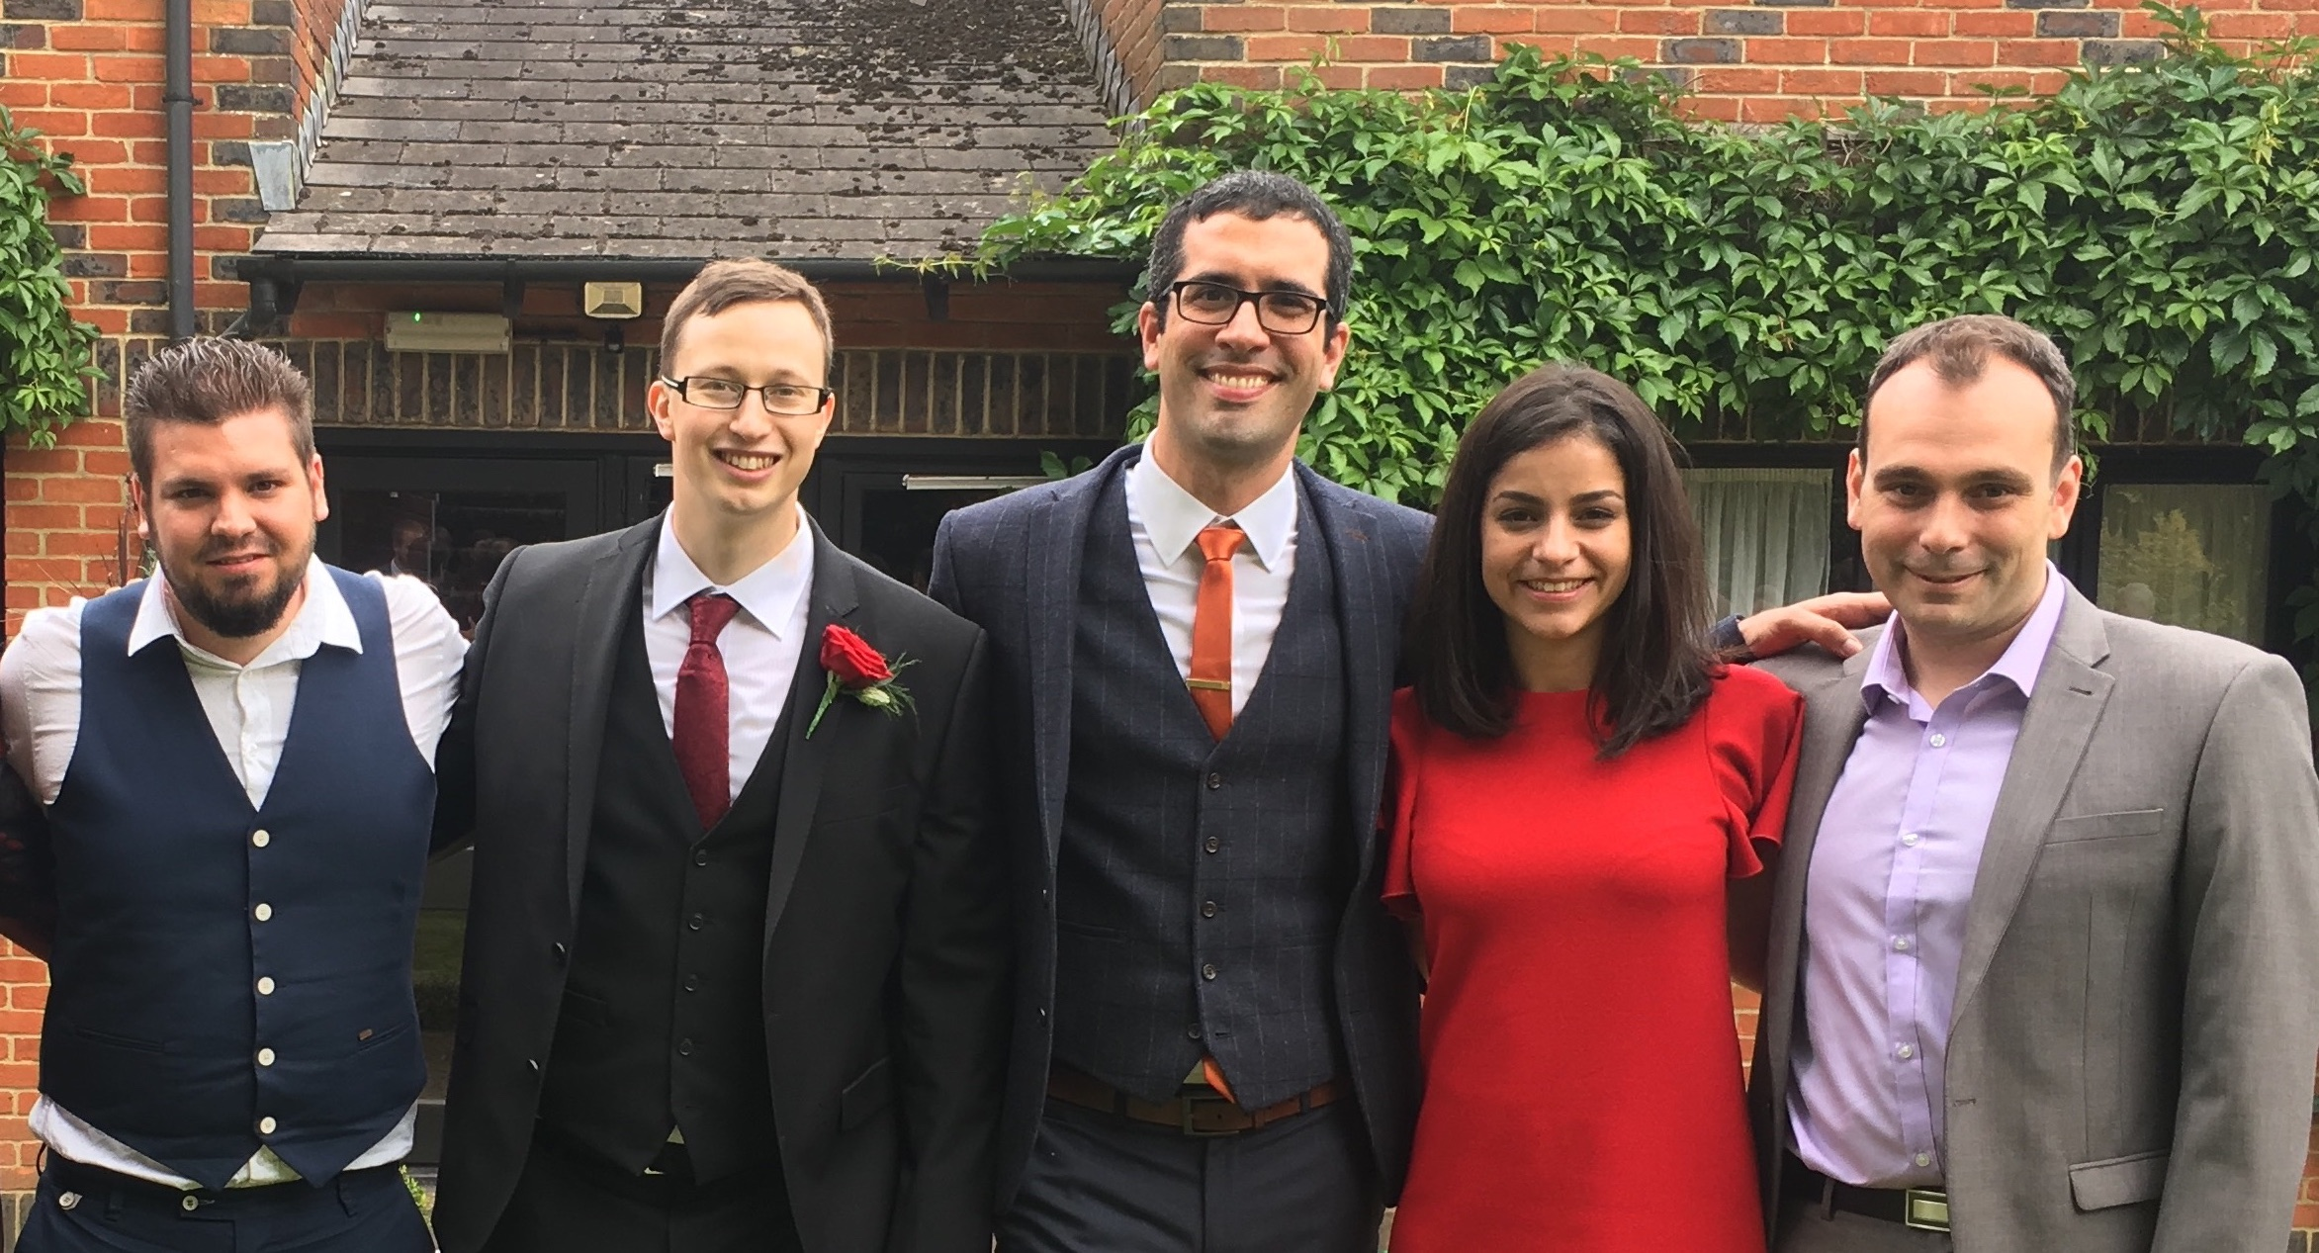
The End (of this talk) and the beginning of your next step…

Slide 62


